Slide 1
Environmental Scan Findings
Compiled results highlighting which sites had the most information available and the unique features which aided in search results.
Office of Quality and Patient Safety
Division of Informatics and Statistics

Slide 2
Goals
Find sites with easy to follow access to detailed and organized data that provided the customer with an easy to understand estimate of how much a medical procedure would cost “out-of-pocket”, taking into account different levels of insurance and location.
Find aspects of website interfaces which presented information in an easy to follow format, and got relevant information to user quickly.
To try to find the best combination of price and quality data to help consumers make an informed decision about their health care options.

Slide 3
Overview
Hospital charges are the base for what the final bill that the consumer will be responsible for. Charges are set by each individual hospital’s specific price guideline, called a chargemaster.
Chargemaster prices are calculated by costs of procedures to the hospital, recourses required for procedures, and also calculate for a certain percentage of profit to the hospital.
These charges are then negotiated down by insurance companies, some more than others. Factors such as the amount of business an insurer brings to the hospital and other available hospitals in area help shape this price.
Different levels of insurance coverage also affect final price to the consumer.
Form of payment can affect final price. For example, paying up front will lower hospital charges in many cases.

Slide 4
Overview
Several sites used in this scan offered price quotes, but were not a free service.
Insurance provider websites wanted membership sign ups in order to provide information on doctors, hospital charges, quality, and location. These sites were not included, due to the fact that the main purpose of this initiative is for free open access to medical pricing information.
If these sites did have useful interfaces or tools which aided in searches, they were cited in the “User Interfaces” portion of this presentation.

Slide 5
Terminology
Common terminology including: charges, costs, payments, prices, and reimbursements and their relationship to final data.
“Charges” often reflected an amount listed on a hospital chargemaster, the amount billed to uninsured or out-of-network patients, or amount billed to insurance companies for a covered visit or service.
“Costs” are mostly used to describe the amount that the procedure is costing the hospital to perform.
“Payments” or “reimbursements” refer to the amount that insurance or Medicare would pay to the hospital. The difference between charge and reimbursement would be left to the consumer.
“Price” or “out-of-pocket” are they key terms that were focused on. These refer to the final amount that a consumer will be responsible for after insurance payments and other deductions have been made.
While many sites are able to provide an approximate or average hospital CHARGE or COST based on their data, finding information regarding the ending PRICE that the customer can expect to be responsible for paying proved to be much more difficult.
All numbers are not intended to be used as price quote for future procedures. Each procedure researched is not a carbon copy of similar procedures performed. Levels of severity and complications they present vary with each individual case.
http://www.effectivehealthcare.ahrq.gov/ehc/products/562/2053/public-reporting-cost-measures-report-150305.pdf

Slide 6
Price Information Overview
The following four slides are sites that give information on “out-of-pocket” amounts or PRICE figures to the user.
Of the 40 sites used in the scan, only these four gave the final price estimation to the user.
Direct comparison of individual hospitals, along with low average and high end price estimations. Colorado, New Hampshire, and FairHealth all had tools which allowed user to enter insurance information to get a more accurate estimation.
NH shows breakdown of what insurance will pay and what consumer will pay.
Docspot provided uninsured vs. Medicare, and also provided details about what services were provided at the primary care office.

Slide 7
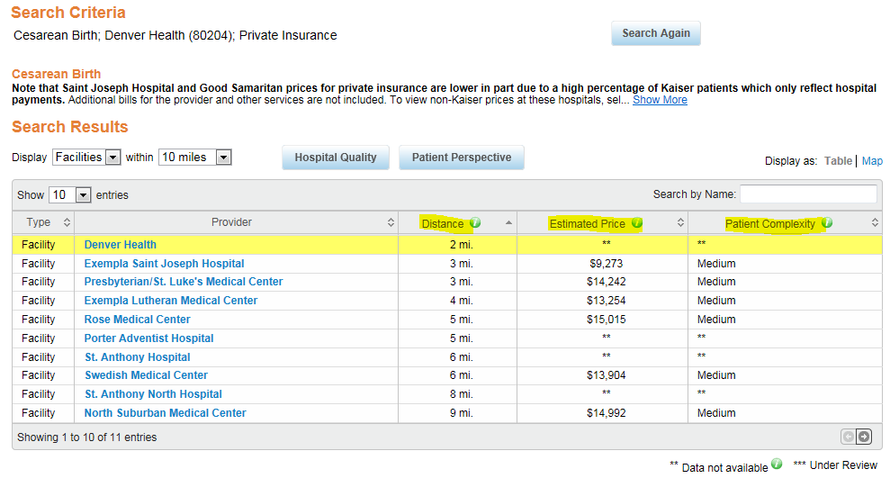
Useful Information Found on Sites
Price information and Estimations
Colorado provides the price estimate instead of the charge.
Site shows direct comparisons between area hospitals.
Provides price range including low and high prices, instead of simply providing average or median.
Tool to enter insurance information to better calculate final price estimate.
https://www.comedprice.org

Slide 8
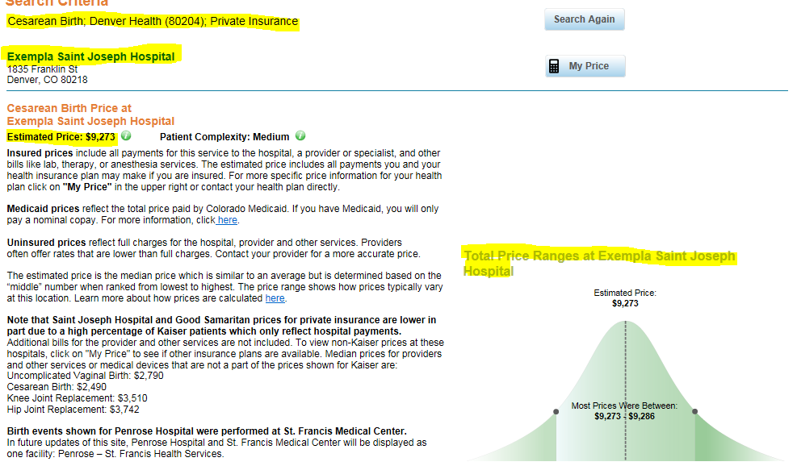
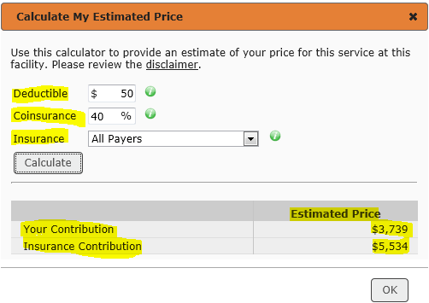
Useful Information Found on Sites
https://www.comedprice.org

Slide 9
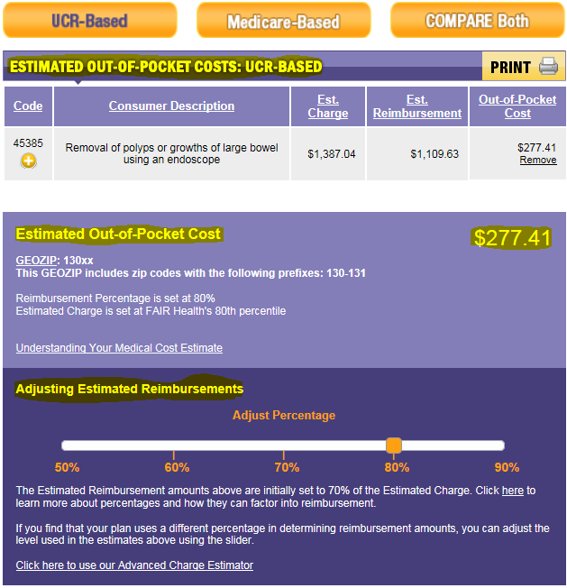
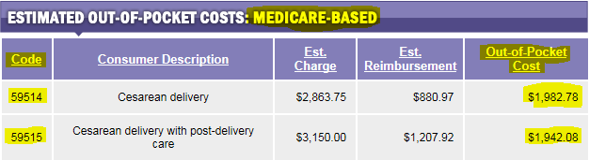
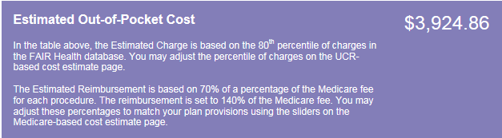
Useful Information Found on Sites
Price information and Estimations
The option to select between Medicare or insurance, based on selected state standards to get more relevant out of pocket cost expectation.
Medical code reference for more accurate lookup. Medical code is used for chargemaster price lookup.
Site also had information regarding charge and reimbursement totals, good to see how much insurance would help.
http://fairhealthconsumer.org

Slide 10
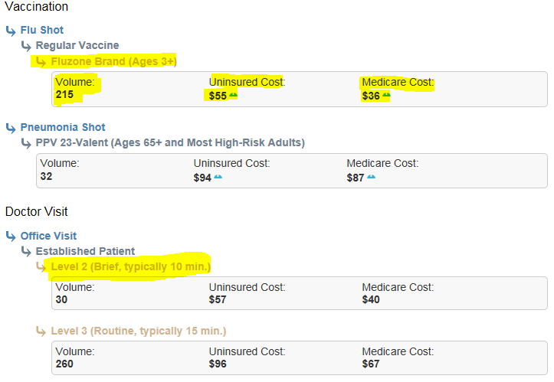
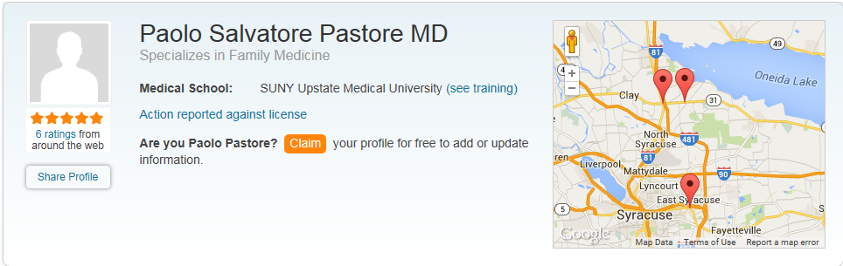
Useful Information Found on Sites
Price information and Estimations
DocSpot had useful information regarding doctors office visits.
Site breaks down cost to uninsured consumer for common procedures as well as what Medicare covers.
Number of procedures performed as well as a description of what visit will typically entail
https://www.docspot.com/user/1754007614?c=208#tabs

Slide 11
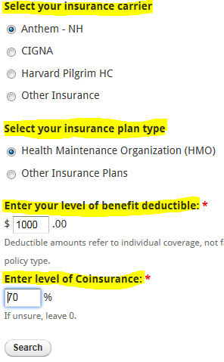
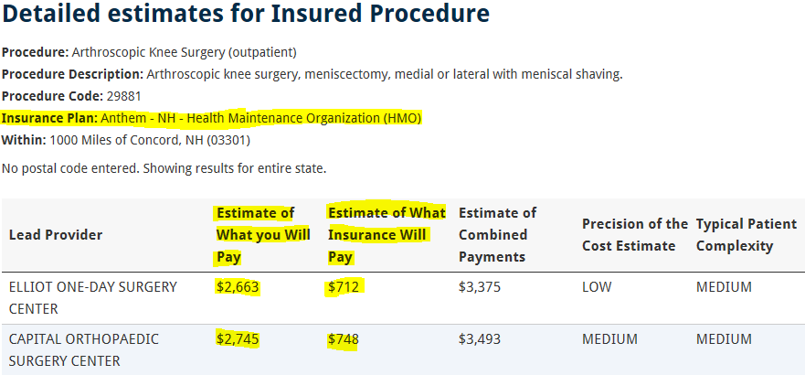
Useful Information Found on Sites
Price information and Estimations
New Hampshire’s state run site allows for selection of insured or uninsured.
Insured customers then get to select one of 3 common insurance options in NH , and enter in their deductible and coinsurance percentage.
Comparison of price directly to consumer against other hospital in defined search radius
http://nhhealthcost.nh.gov/

Slide 12
Useful Information Found on Sites
All 4 sites had an estimated final “out-of-pocket” cost to the consumer. This removes some of the margin of error than can be associated with giving out median or average “charges”.
The ability to enter in and adjust insurance policy rates to get a more accurate price is very useful and not found on any other web sites.

Slide 13
Charge Information Overview
The following sites have valuable information, but are based on what the hospital charges, not factoring in special rates for insurance companies or any payments made by them.
Several sites also post more categories on charge information because they are based off hospital records, without having to show bargaining rates with insurance carriers. There is more information available on charges opposed to price information.
Sites that broke down the charge of the facility and the professional charge instead of one lump sum. Some even included charges for the equipment used, like anesthesia.
The ability to select from different procedures on same body part instead of just selecting one overall procedure. Listing the medical code as well.
Ranking systems for the charges of different hospitals. The ability to see whether charges are fair or not based on comparisons in the rest of the selected state, or against national averages.

Slide 14
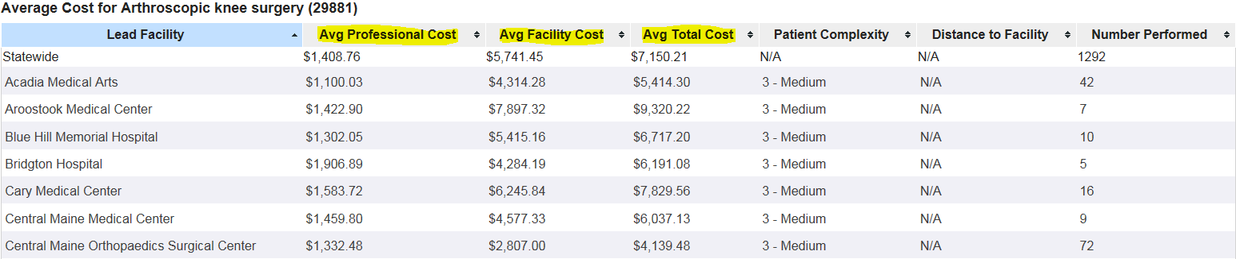
Useful Information Found on Sites
Charge estimations and breakdowns
The state run Maine site provides a breakdown of what the final charge will be, by breaking it up between the facility cost and the professional cost.
The professional cost is what the doctor performing the service charges, and the facility cost is the charge the hospital levels for use of its equipment and rooms.
Allows for comparison between rest of state and individual hospitals.
https://mhdo.maine.gov/healthcost2014/CostCompare

Slide 15
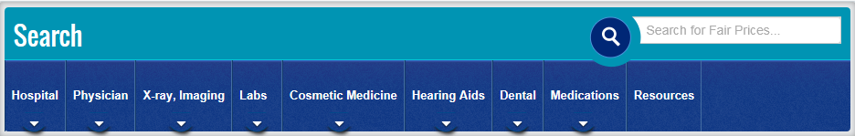
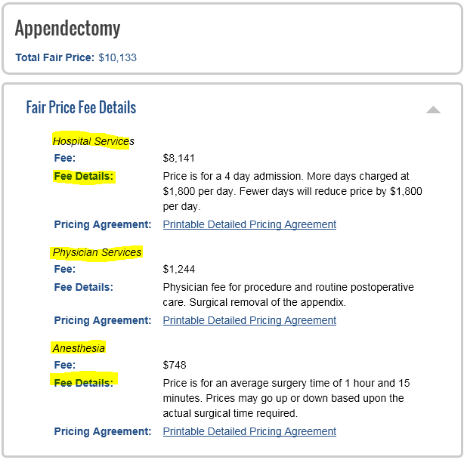
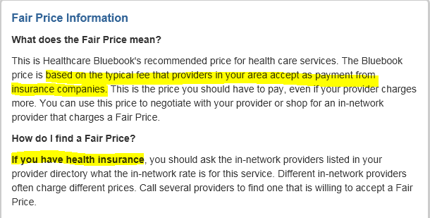
Useful Information Found on Sites
Charge estimations and breakdowns
Health Care Blue Book offers what they call a fair price fee. This is going off the assumption that the user does not have insurance. It is based off what providers in the local area accept as payment from insurance companies.
Site has many services to select from other than hospital or physician, including lab work and imaging.
https://healthcarebluebook.com

Slide 16
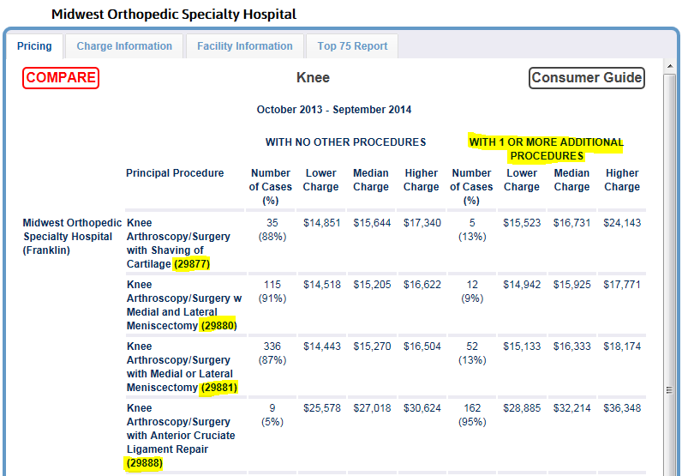
Useful Information Found on Sites
Charge estimations and breakdowns
Sites with information regarding approximate charge for additional procedures that may be required
http://www.wipricepoint.org/

Slide 17
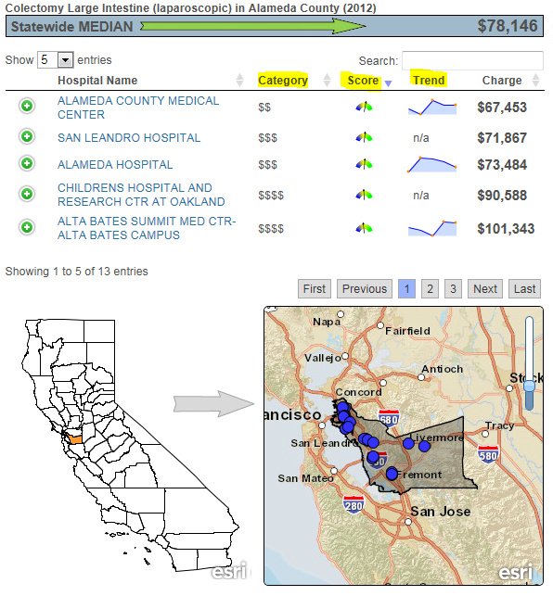
Useful Information Found on Sites
Charge Estimations and breakdowns
Hold cursor over “Trend” column to see trend of charges over the past 10 years.
Hold cursor over “Score” column to see charge score compared to the rest of the state.
Hold cursor over “Category” column to see what percentile group hospital falls under in regards to how expensive it is.
http://gis.oshpd.ca.gov/atlas/topics/financial/common_surgery

Slide 18
Charge Information Summary
The ability to view more information about how the charges are totaled is a benefit of listing charges. Having more information on the charge rates allows sites to do that.
Because these numbers do not represent the final adjusted price, the high price tag associated with the procedures can not be looked at as the best option for presenting information.

Slide 19
User Interfaces Overview
The amount of information found on a website is important, but if it is too complicated to find, or is presented in a hard to follow structure the customer may still not get the information they need.
Some sites may not have had the best information available, but their ease of use or website tools had a favorable impact on the site.
On the other hand, a site could have some great information, but if it is not easy to navigate or is presented poorly, the end result will still be poor.
The sites listed in this section have features that set them apart in regards to accessing, filtering, and presenting the information.
The following two slides are examples of poor user interfaces.

Slide 20
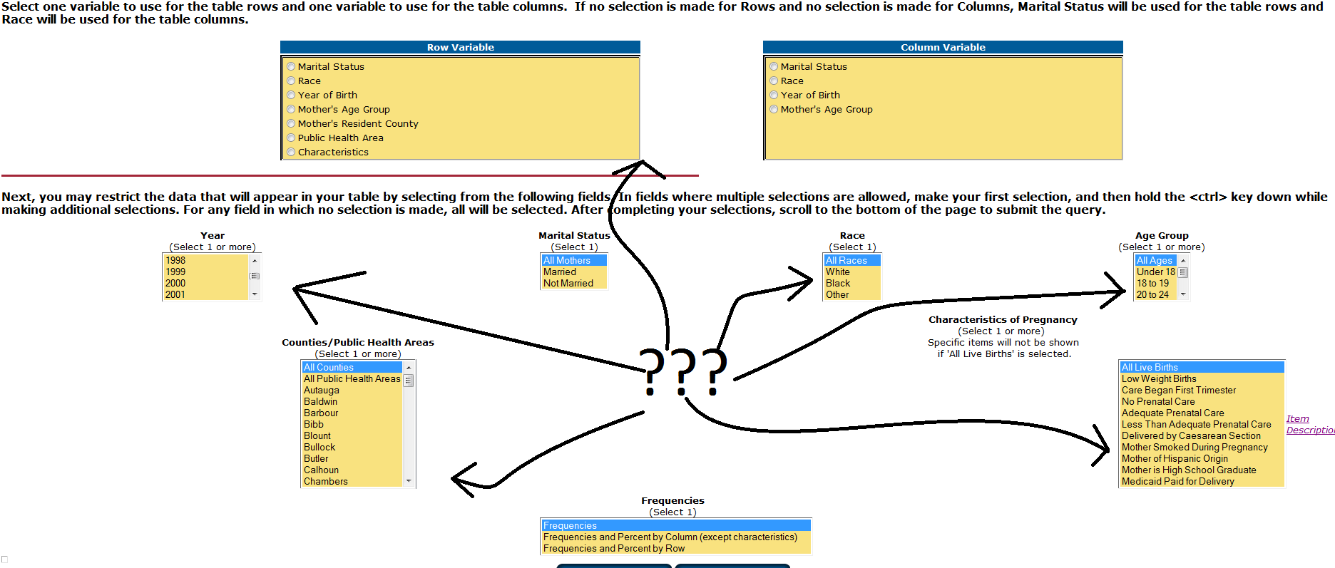
Poor User Interfaces
This is the actual layout of Alabama’s site. The only alterations that were made for this presentation are the lines and question marks with them.
The data selections are in no apparent order and are not presented in a logical fashion. Directions do not provide clear step by step instructions. In this example, the site ultimately gives the user the information they want, but having to go through this process does not leave a favorable impression.
http://ph.state.al.us/csc/vs/Query/Natality/NatalityQrySLT.htm

Slide 21
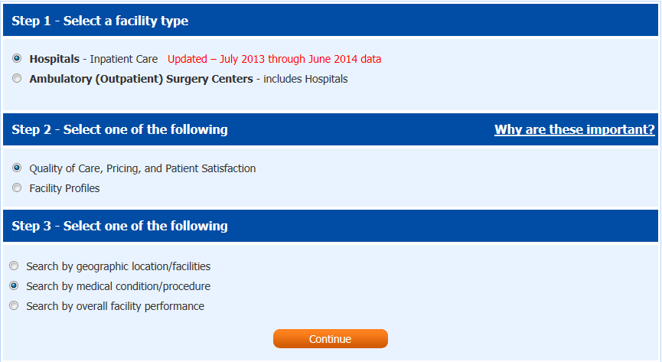
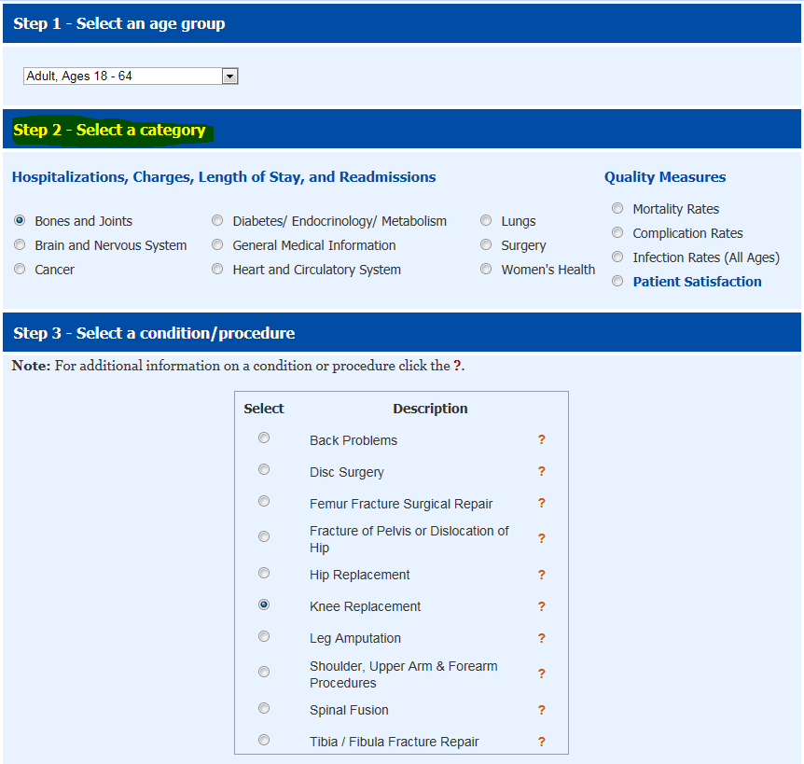
Poor User Interfaces
Organized well and easy to follow, but limited categories to select from.
Lack of selections forces user to try to determine which general description procedure may fall in, and to go searching through site to find procedure if they guess wrong.
Descriptions do not point to a specific procedure, leaving a large room for error. There are many different knee replacements that could be performed, site simply lumps them into one “description”.
http://www.floridahealthfinder.gov/CompareCare/SelectProcedureCondition.aspx

Slide 22
Poor User Interfaces
The first slide was a site for looking up the most common baby names for a given year in the sate of Alabama. The page screenshot was not altered other than the question marks and lines drawn.
Selection filters scattered all over the page with no apparent formatting and directions that left the user wondering if they were even getting the information they wanted.
Florida site was a good layout but to simply lump all knee replacements or other detailed procedures in to one description is not providing the consumer with the best information

Slide 23
Positive User Interfaces
The following sites are ones that made finding and organizing information easy. Using tools like maps, one page navigation, or insurance calculators made it possible to get the most accurate information as quickly as possible.

Slide 24
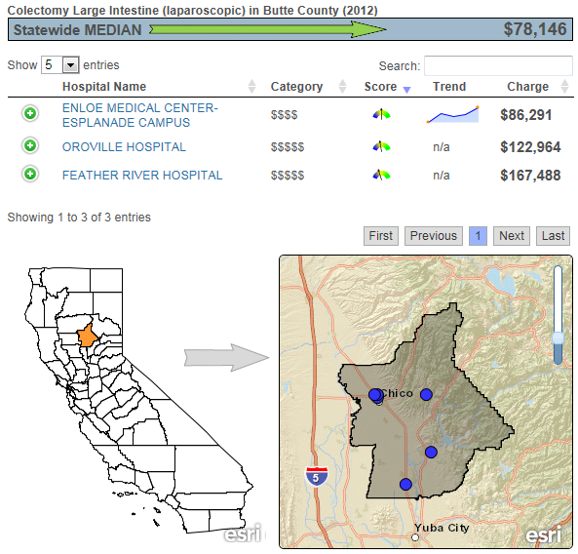
Positive User Interfaces
Interactive Maps
Maps showing where hospitals are located throughout the state, sorted by county. All information presented in one clean, easy to follow and navigate map with dots representing listed hospitals location.
Hovering cursor over “category”, ”score”, and “Trend” displays will bring up pop up menu with numerical score and ranking. This gives a visual and numerical representation for quality.
Clicking on different county in State map will bring up other hospitals charges without having to start a new search or open new window.
http://gis.oshpd.ca.gov/atlas/topics/financial/common_surgery

Slide 25
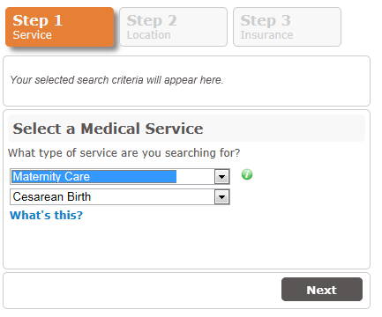
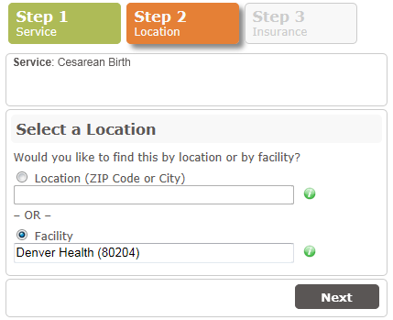
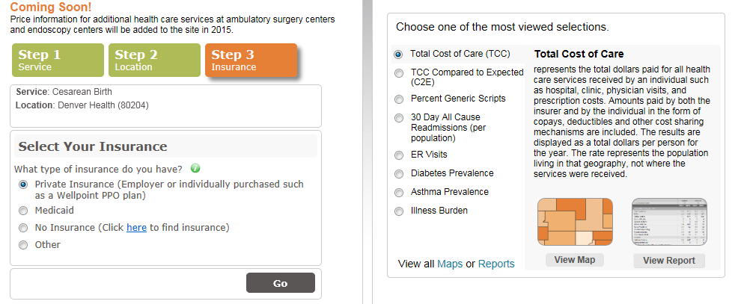
Positive User Interfaces
Simple to use tabs that keep user on the same page while providing clear, step-by-step directions.
Auto-Fill drop downs to help user find information they are looking for.
Tools for selecting insurance options to get more accurate results.
Filters to display only information that user wants.
https://www.comedprice.org

Slide 26

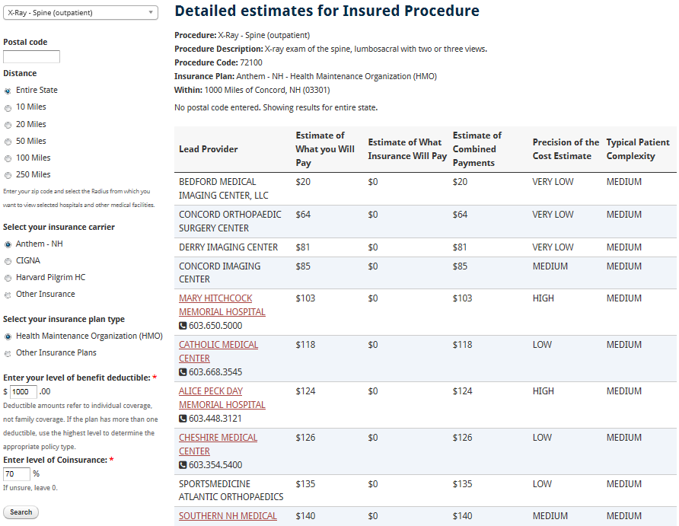
Positive User Interfaces
Same page navigation
2.
3.
4.
5.
6.
1.
7.
After 7 simple selections, data is presented and summarized all in one neat table.
Able to get more information on individual hospital by clicking under provider column.
Direct comparisons available, no need to jump around to different pages.
User can select new procedure or change insurance options while staying on same page.
http://nhhealthcost.nh.gov

Slide 27

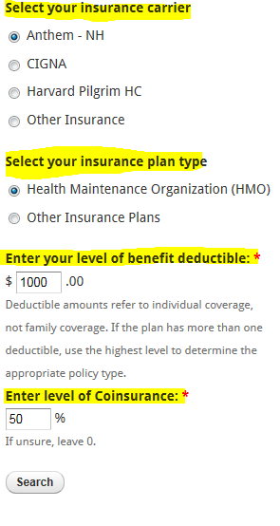
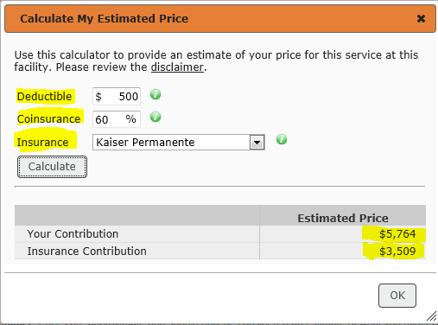
Positive User Interfaces
Insurance calculators
Tools which allow user to enter insurance information.
http://nhhealthcost.nh.gov/
https://www.comedprice.org

Slide 28
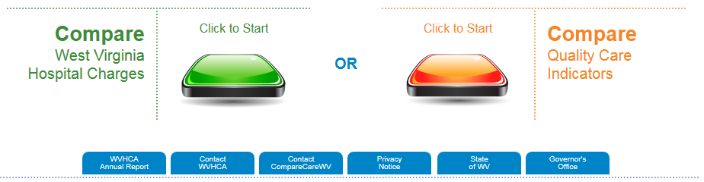
User Interfaces
Filter tools
Ability to select charges or reviews. Allows user to get to desired information quicker.
Clearly distinguishes a difference between charge and quality.
http://www.comparecarewv.gov/

Slide 29
User interfaces Review
Most sites that had easy to use tools and clear instructions also had the best information available as well.
The ability to clearly distinguish between quality and cost measures clearly distinguishes a difference between the two. If the consumer didn’t think, or know, to look for one or the other before using the site they were able to after.

Slide 30
Quality Overview
Quality has a wide range of meaning depending on which website is providing the information.
Use of antibiotics, length of stay, numbers of beds in a hospital, infection rates, whether a hospital is certified as a teaching location are some of the many factors that fall under quality measures.
Not all sites list, or use all available factors. Some simply post one or two quality measures that they have information on and let the user determine its relevance.
Other sites provide a rating system based on reviews that they have received from patients. The problem being that not all patients participate in the surveys, and some hospitals don’t participate in every quality survey that is available.
When used properly, quality measures can sometimes help explain why some hospitals charge more than others, or influence what hospital the consumer wants based on previous performances.
Some consumers would rather pay any amount for a service if they believe the quality of care
they will be receiving outweighs the potential saving that may be occurred by going to a hospital with lower quality ratings.
It should be noted however that high cost may not always be associated with high quality and vice versa. Part of the intended outcome of price transparency is establish a clear biases for how the hospitals come up with their prices.

Slide 31
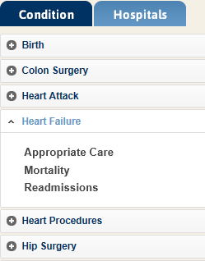
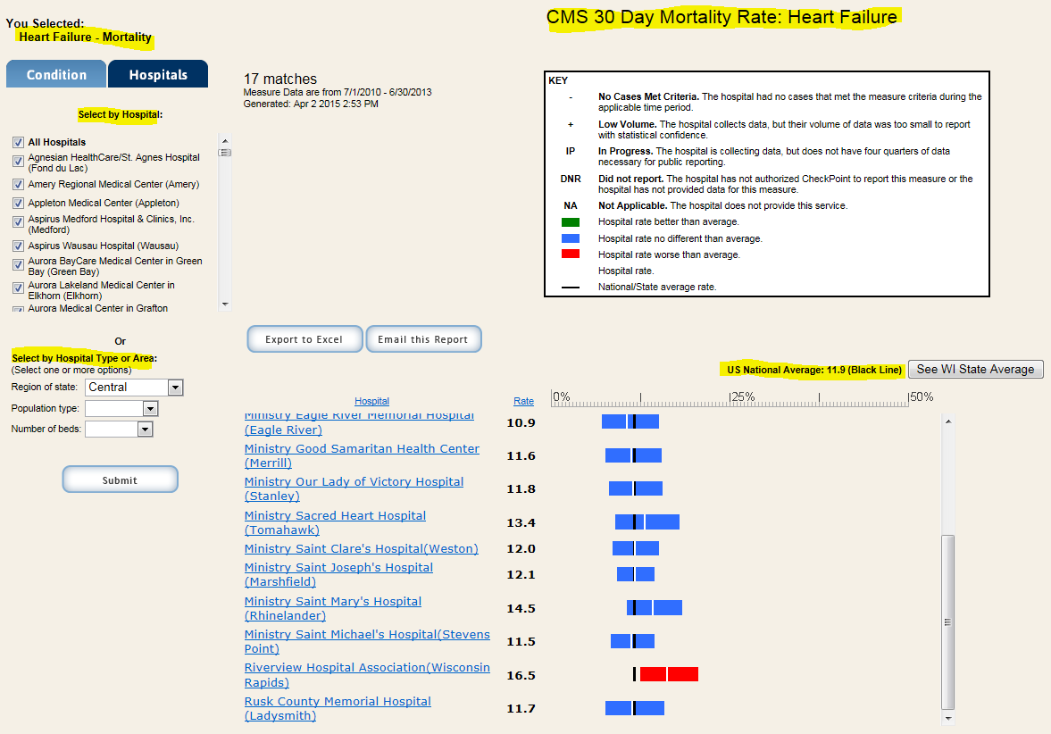
Quality Measures
Ability to select from drop down menus to select condition and metric to compare it with.
Charts which provide keys and show where hospital ranks against state and national averages.
http://www.wicheckpoint.org/report_topic_cmsmr.aspx?tab=2&mode=MortalityHeartFailure

Slide 32
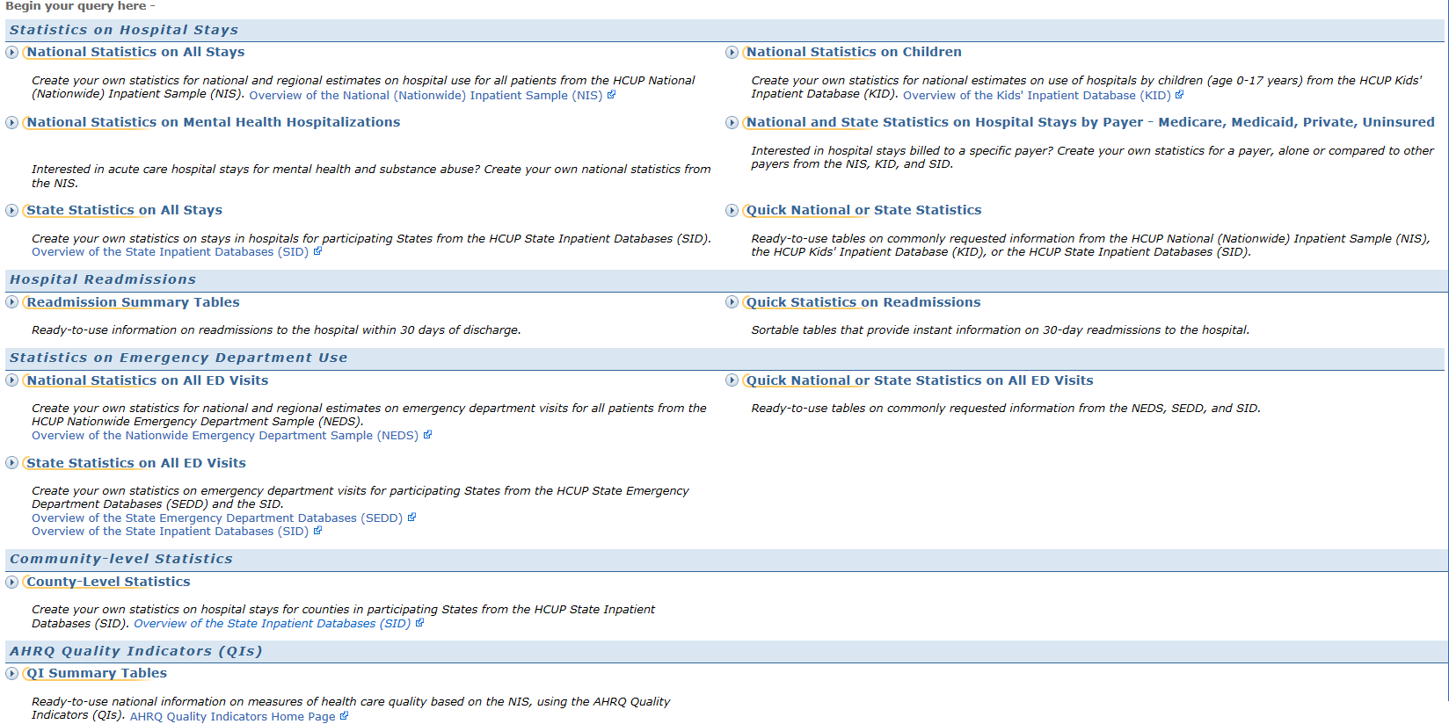
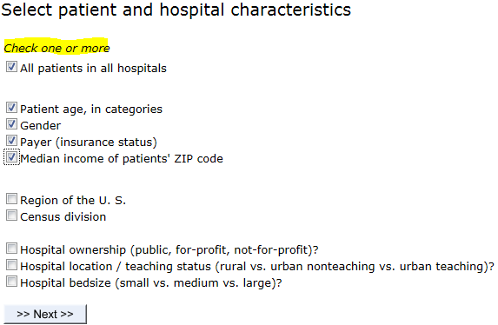
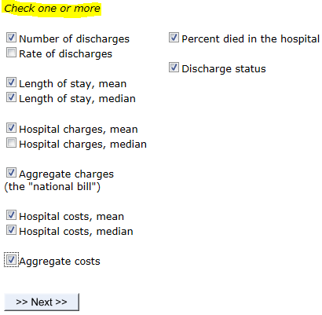
Quality Measures
http://hcupnet.ahrq.gov/HCUPnet.jsp

Slide 33
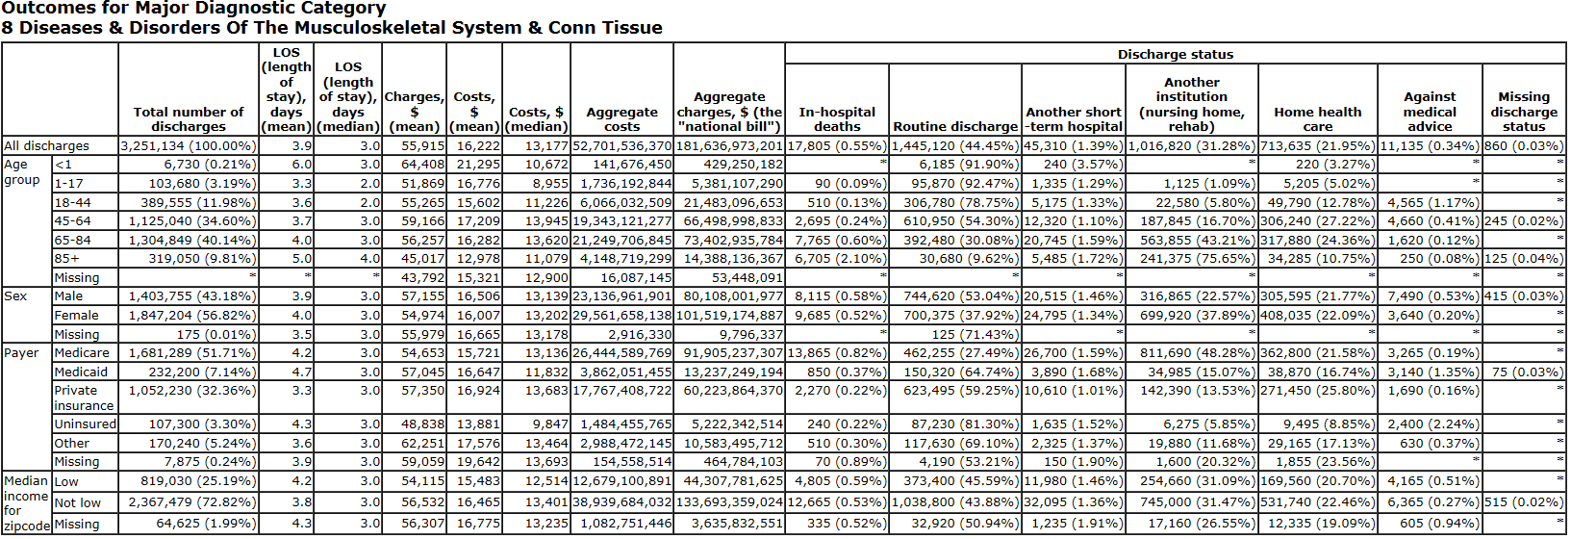
Quality Measures
This is the most informative page that was used. Plenty of information on charges and costs
One of the few site to actually quantify quality. Giving hard data and numbers is more assuring that a simple bar graph or star rating system that most other sites use.
Site allows user to select what statistics they want displayed. It is a nice feature to have, but all this information in one place can still be hard to sort through even with selecting only information user wants to display.
This graph represents about 75% of available selections that can be made. Also this chart is only one of several other graphs that were displayed on final page.
http://hcupnet.ahrq.gov/HCUPnet.jsp?Id=85D0316856E8D034&Form=DispTab&JS=Y&Action=Accept

Slide 34
Quality Review
There is not one general standard used to define quality when it comes to health care, many factors can be included.
What appeared to be the best approach was to have some simple type of rating system in the final output, with the ability to get more information regarding how the score was calculated if wanted.
Ideally the best option would be to have detailed quality measures on the same site as opposed to sending user off to another website. Easier to get that “one stop shopping” feel.

Slide 35
End Goal
The main thought process during the course of this project has been “If I am a consumer looking for health care prices, what helps guide me to the information I want, and what am I going to avoid looking for or using?” After completing the environmental scan, several observations could be drawn.
Finding out-of-pocket costs was the primary goal when examining sites. How easy it was to get and view to those numbers was second. Lastly, quality information and availability was considered.
This process is not set in stone however. If focus groups determine quality or other options to be the priority, then adjustments can and will be made to the overall presentation.
The next section will be a crude layout plan for an ideal health care expense website. It will have no functionality or credibility, and is compromised of tools selected from other websites cited previously.
The indicate a mouse selection on the mock up which will bring up the next slide or “page” on the site.

Slide 36
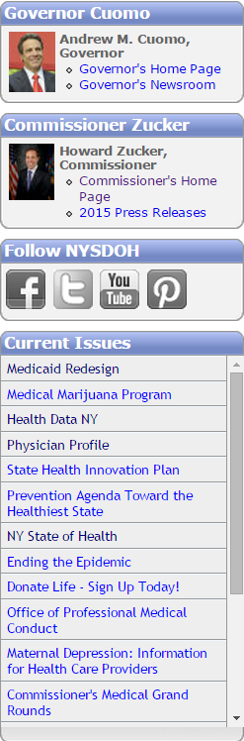

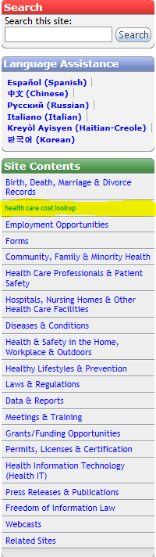

Slide 37

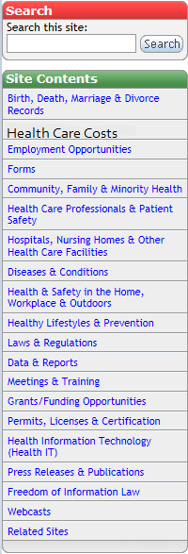

Search through New York State’s Health Data NY resources to find out how much you can expect to pay for a medical procedure. To get started, select the green button if you have some form of insurance. Select the orange button if you are uninsured.
**Selections can be altered to cover other insurance. It is not just limited to insured or not. One button could represent government supported health care, other private. For this demonstration it is limited to covered or not**

Slide 38


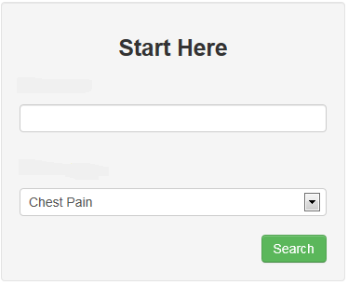
Location zip code or select area to view hospitals
Procedure or Medical Code

Slide 39
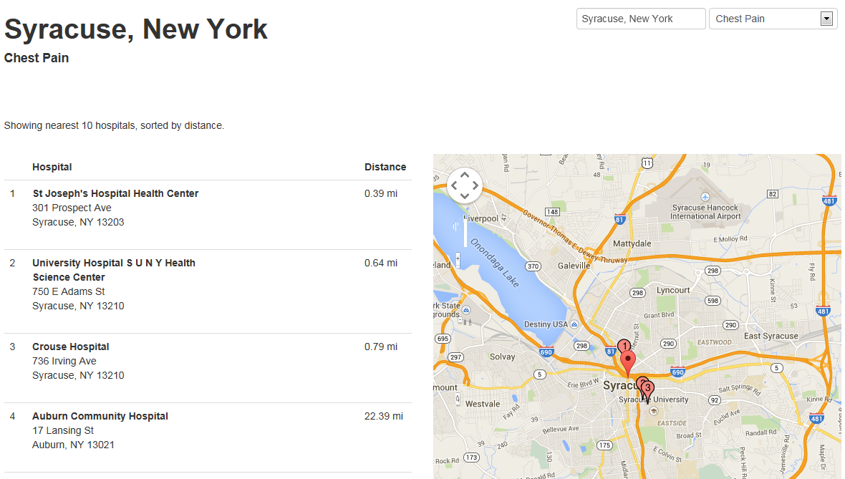
The best websites were the ones that allowed for viewing location, selecting, and then comparing prices directly against each other. Selected Chest Pain from drop down menu.
Select to Compare

Slide 40
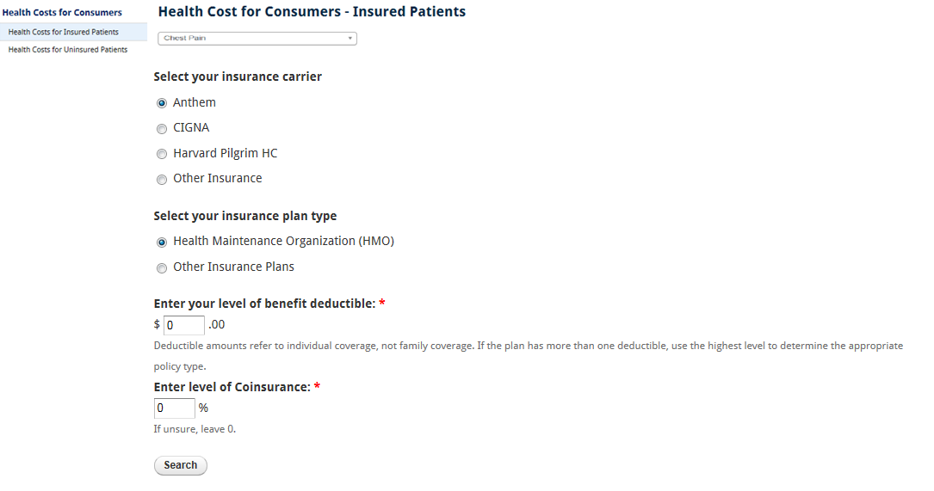
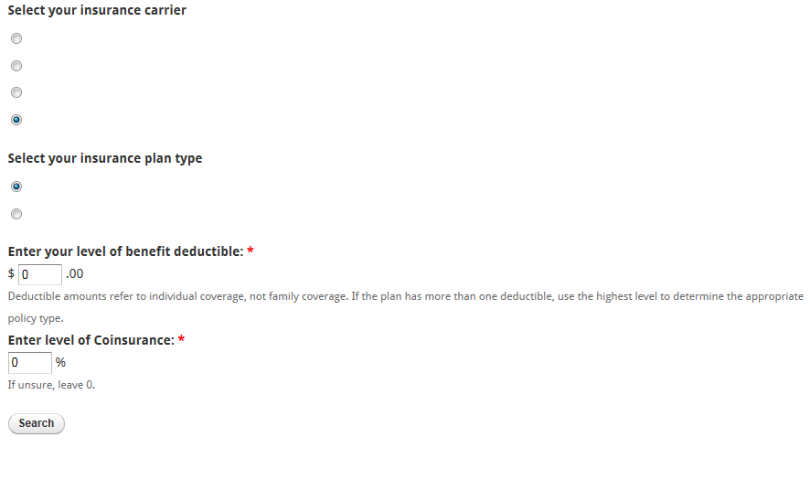
A step in the process which allows user to enter in insurance information to calculate the most accurate price estimation possible.
MVP Healthcare
MAKE SELECTIONS NYS COMMON INSURANCE. CDBCBS, EMPIRE, MVP.
Pop up window for selection of “other” insurance
Please select from available options
Alpha Insurance
Beta Insurance
Bruce Wayne LLC
I Am Batman Inc.
Charlie Insurance
Don’t you Want Insurance? Inc.
Blue Cross Blue Shield NY
Empire
Other
Health Maintenance Organization (HMO)
Other

Slide 41
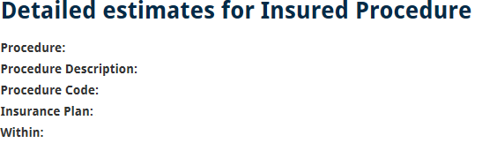


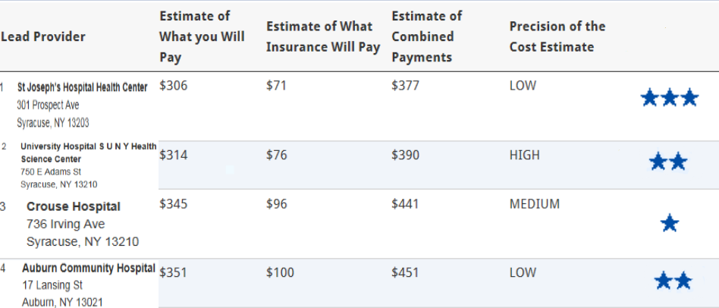
For more information on hospital quality score, click on star rating (IPRO). Have it in same presentation as IPRO Site
For more price information on a specific hospitals price breakdown, select hospital under Lead Provider column.
Chest Pain
Emergency room visit for chest pain
99238
MVP Healthcare
20 Miles of Zip Code 13039
Hospital Quality Score
Insurance calculator tool available to change providers or cost compare.
Drop down menu available to change search result and not have to re-enter information again.

Slide 42
Web site Conclusions
Most of the emphasis is on finding price, with quality information becoming a selection at the end in this demo.
Several key features that were incorporated for ease of use. Price v Quality selection Interactive map hospital selection Hospital comparison Insurance information input Drop down menus Quality rating and numbers Key definitions of terms
Sites that had auto-fill or easy to follow drop down menus were a plus, and were incorporated.
The ability to either change you insurance information or medical condition without having to go through entire step by step process again.
Demo page based off of NY DOH main page. Can be changed to fit other sites like Health Data NY

